Slide 1
Physical Exercise Form Correction Using Video Processing
RNS INSTITUTE OF TECHNOLOGY
BENGALURU - 98
DEPARTMENT OF INFORMATION SCIENCE & ENGINEERING
Final Year Project Work Phase I Presentation
Candidate Names
USN 1: 1RN19IS095
USN 2: 1RN19IS121
USN 3: 1RN19IS127
USN 4: 1RN19IS175
Panel
Mrs. Vinutha G K
Asst. Prof, Dept of ISE, RNSIT
Internal Guide
Mrs. Sunitha K
Asst. Prof, Dept of ISE, RNSIT

Slide 2
AGENDA
Introduction
Literature Review
Problem identification
Objectives
System Design
Methodology
Conclusion
References

Slide 3
INTRODUCTION
Background
Doing exercises the right way is not an easy task. If the user wants serious results he/she has to learn the correct way of training. The wrong posture or technique is not just ineffective, it can also lead to serious injuries. Having a personal trainer reduces these risks, but it is expensive and gyms can become overcrowded.
Existing system
In the past, many studies have engaged in the detection of fitness movements, among which the detection of fitness movements has been done based on wearable devices, body nodes. However, a wearable device cannot detect a variety of fitness movements, may hinder the exercise of the fitness user, and has a high cost. Both body-node-based and image-deep-learning-based methods have lower costs, but deep learning has more efficient performance.

Slide 4
INTRODUCTION
Proposed System
Image/video processing and deep learning methods might have the potential to achieve better performance. Therefore, this project aims to use these methods to virtually perceive and correct the user’s posture.
We use real-time streaming of the user’s video in order to identify their posture and subsequently indicate to them if they are going wrong.

Slide 5

LITERATURE REVIEW
 | Heading/year | Model | Datasets | Performance measure | values
1 | Assessing human motion during excercise | Hidden Markov model(HMM), Dynamic time wrapping(DTW) | Motion caption systems,Mocap | Accuracy | 67-86%
2 | Physical exercise form correction | Convolutional neural networks | Images from frontal camera | Accuracy | 65% and above
3 | Human pose estimation in the field of sport an physical | CNN-Convolutional neural networks | Dancing and sports datasets(MADS),HPE,Mocap | OKS,PCK,RMSE

Slide 6
LITERATURE REVIEW
4 | Machine learning technique for identification of yoga poses | SVM,Logistic regression,naïve bayes,KNN,Random forest | Yogi dataset | Accuracy | 94.28%
5 | Detecting unseen anomalies in weight training excercise | Chain rule on change of position function | Motion sensor data | Mean,standard deviation | 94%
6 | Posture correction using human pose estimation | CNN | MPII | Accuracy

Slide 7
LITERATURE REVIEW
7 | Automatic evaluation of exercise on sensor equippes weight training machies | Artificial neural network (ANN) | Weights training machines with sensors | Accuracy | 93%
8 | Qualitative activity recognition of weight lifting excercise | Feature extraction | vedio | classification | 78.2%
9 | Pose trainee:correcting exercise posture using pose estimation | Convolutional neural networks | Recorded vedio

Slide 8
Problem identification
Certain types of exercises can be challenging for new users. You may face problems like not being sure how to perform the exercises or how to engage your muscles. Without a professional to correct your form and technique, how can you tell if you are performing these exercises correctly?
If the workouts are too difficult to keep up with, you may need to try a easier routine. Walking or jogging 2 – 3 times a week does not necessarily mean that you are able to follow home workouts. Not all exercises are equal as the skills required are vastly different.
Having no motivation to keep on working out everyday or frequently can be a very huge problem when the user is over-worked, irritated, sore. Even when there are far too many distractions to the user like television and the social media to waste time.

Slide 9
Objectives
Fitness is important in people’s lives. Good fitness habits can improve cardiopulmonary capacity, increase concentration, prevent obesity, and effectively reduce the risk of death.
The system has to be consistent in detection of wrong postures which might lead to injuries, which finally can lead to improper gains.
Helps in tracking sets and repetitions of exercise. Provides motivation by tracking timely achievements.
Helps in maximizing consistent gains.

Slide 10

System Design
Project workflow-

Slide 11

SYSTEM DESIGN
Web architecture

Slide 12
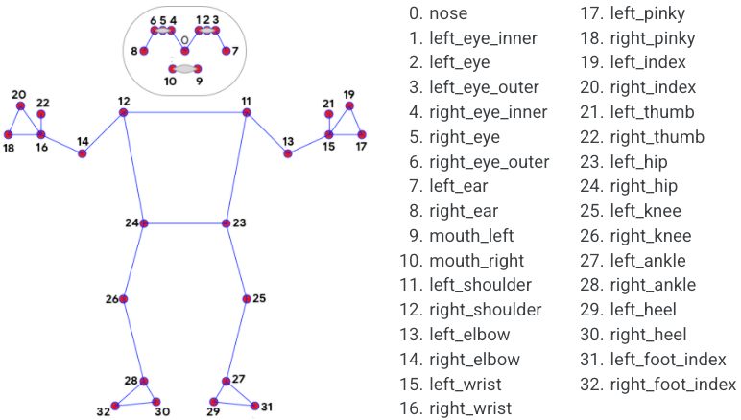
METHODOLOGY
Overview

Slide 13
METHODOLOGY
The video sample is first gathered by MediaPipe’s calculator graphs which are used to process streams of video and audio frames by receiving successive packets with increasing timestamps.
The solution utilizes a two-step detector-tracker ML pipeline.
Using a detector, the pipeline first locates the person/pose region-of-interest (ROI) within the frame.
The tracker subsequently predicts the pose landmarks and segmentation mask within the ROI using the ROI-cropped frame as input.
A skeleton of the region of interest is created by MediaPipe which is trained on the Objectron dataset.
Finally, the created skeleton is checked manually for each exercise by defining the joint angles required for it to be executed correctly.

Slide 14
CONCLUSIONS
It also provides motivation for the user to exercise by displaying timely achievements and milestones . By maintaining a record of all previous exercises, it can create and present the user’s routines and activities in the form of reports.
This project presents a labeled dataset for training Deep Learning models to help correct posture in Physical exercises . It proposes a solution based on Convolutional Neural Networks and evaluates the performance under different environmental conditions (background, camera angle, distance etc.).
The project focuses to display a notification when the user reaches a certain milestone, such as completing a certain number of workouts or reaching a certain number of steps. This makes the user to feel a sense of accomplishment and encourages them to keep up their exercise routine. Additionally, the model offers rewards for reaching certain milestones, such as discounts on gym memberships or access to special content. This can further motivate the user to stay active and engaged with the project .

Slide 15
REFERENCES
[1] https://mediapipe.dev/
[2] A. Rahmadani, B. S. Bayu Dewantara and D. M. Sari, "Human Pose Estimation for Fitness Exercise Movement Correction," 2022 International Electronics Symposium (IES), 2022, pp. 484-490, doi: 10.1109/IES55876.2022.9888451.
[3] Militaru, C., Militaru, M.D. and Benta, K.I., 2020, October. Physical Exercise Form Correction Using Neural Networks. In Companion Publication of the 2020 International Conference on Multimodal Interaction (pp. 240-244).
[4] Biebl, J.T., Rykala, M., Strobel, M., Bollinger, P.K., Ulm, B., Kraft, E., Huber, S. and Lorenz, A., 2021. App-Based Feedback for Rehabilitation Exercise Correction in Patients With Knee or Hip Osteoarthritis: Prospective Cohort Study. Journal of Medical Internet Research, 23(7), p.e26658.
[5] Królak, A., Wiktorski, T., Bjørkavoll-Bergseth, M.F. and Ørn, S., 2020. Artifact correction in short-term hrv during strenuous physical exercise. Sensors, 20(21), p.6372.
[6] Velloso, E., Bulling, A., Gellersen, H., Ugulino, W. and Fuks, H., 2013, March. Qualitative activity recognition of weight lifting exercises. In Proceedings of the 4th Augmented Human International Conference (pp. 116-123).

Slide 16
REFERENCES
[7] Chen, S. and Yang, R.R., 2020. Pose Trainer: correcting exercise posture using pose estimation. arXiv preprint arXiv:2006.11718.
[8] Novatchkov, H. and Baca, A., 2012. Machine learning methods for the automatic evaluation of exercises on sensor-equipped weight training machines. Procedia Engineering, 34, pp.562-567.
[9] Agrawal, Y., Shah, Y. and Sharma, A., 2020, April. Implementation of machine learning technique for identification of yoga poses. In 2020 IEEE 9th international conference on communication systems and network technologies (CSNT) (pp. 40-43). IEEE.
[10] Frangoudes, F., Matsangidou, M., Schiza, E.C., Neokleous, K. and Pattichis, C.S., 2022. Assessing Human Motion During Exercise Using Machine Learning: A Literature Review. IEEE Access, 10, pp.86874-86903.

Slide 17
THANK YOU

